Slide 1
FY 2025 – 2029 Tentative Five-Year
Transportation Facilities Construction Program March 19, 2024
Associated General Contractors of America, Arizona Chapter
Notes:
1

Slide 2
2025-2029 Program Discussion
Program Development Status
Greater Arizona
Maricopa County
Pima County
Next Steps

Slide 3
ADOT 5-yr Program Development Process
We are here

Slide 4
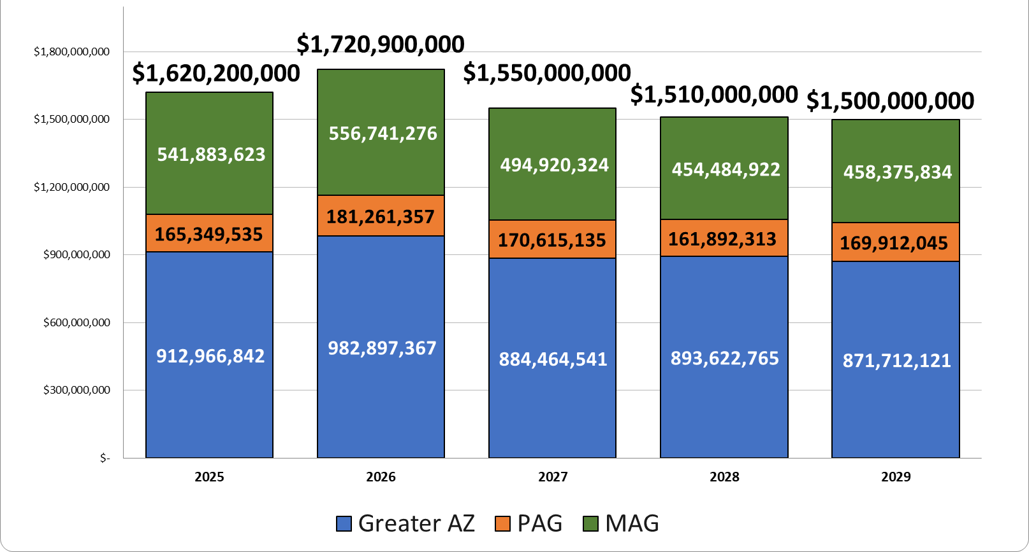
Program Funding and Distribution

Slide 5
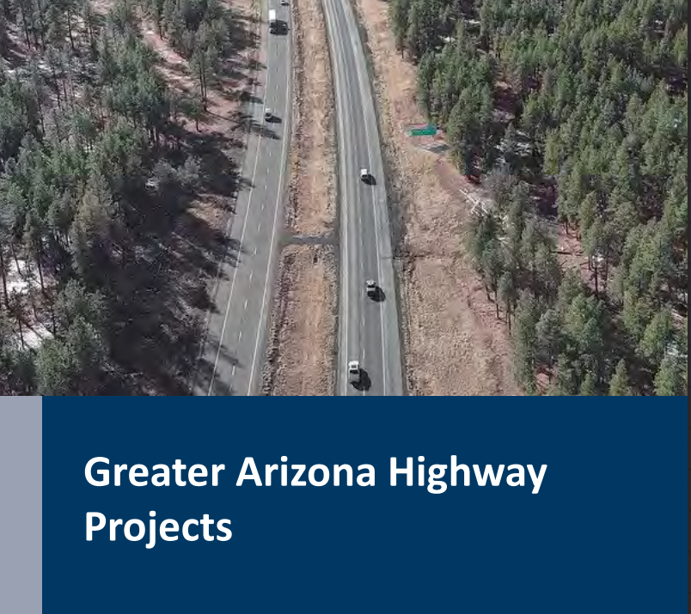
Greater Arizona Highway Projects
Five year total $4.55 bil
50% programmed by Board
Excludes Maricopa and Pima Counties
Includes subprograms and local projects funded from competitive subprograms
Construction projects prioritized as required by statute

Slide 6
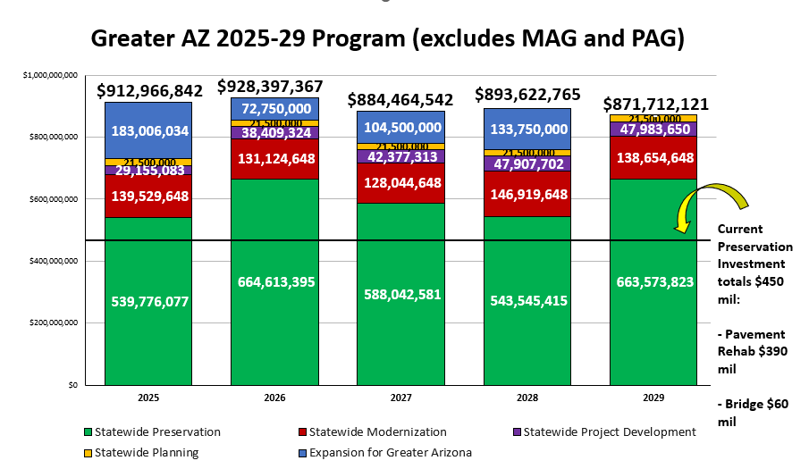

Slide 7
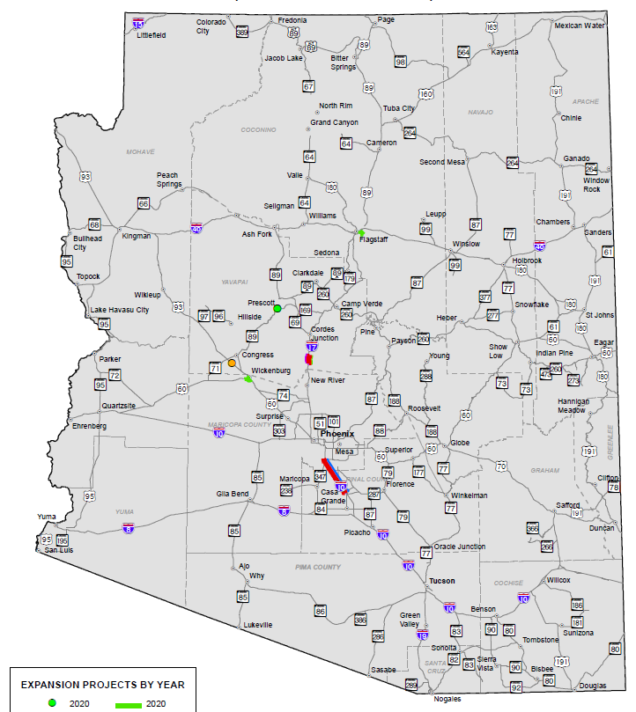
2025 Expansion Construction Projects – $183 M
$77.5 M; US 93 W Kingman TI
(Construction, yr 2 of 2)
$10.5 M; US 93 Vista Royale (Design)
$35 M; US 93 Cane Springs
(Construction, yr 2 of 3)
$30 M; I-10 Riggs Road to SR 387
$30 M; I-10 SR 587 to SR 387
$41.25 M; US 191 Cochise RR Overpass Major preservation project (not included in Expansion total)
Expansion Projects
Planning Costs
Development Costs
Modernization Projects
Preservation Projects

Slide 8
2026 Expansion Construction Projects – $72.8 M
$35 M; US 93 Cane Springs
(Construction, yr 3 of 3)
$10.5 M; US 93 Big Jim Wash (Design)
$27.25 M; SR 260, Lion Springs
(Construction, yr 1 of 3)
Expansion Projects
Planning Costs
Development Costs
Modernization Projects
Preservation Projects

Slide 9
2027 Expansion Construction Projects – $104.5 M
$54.5 M; SR 260 Lion Springs
(Construction; yr 2 of 3)
$50 M; US 93 Big Jim Wash
(Construction; yr 1 of 2)
Expansion Projects
Planning Costs
Development Costs
Modernization Projects
Preservation Projects

Slide 10
2028 Expansion Construction Projects – $133.8 M
$27.25 M; SR 260 Lion Springs
(Construction; yr 3 of 3)
$60 M; US 93 Big Jim Wash
(Construction; yr 2 of 2)
$46.5 M; US 93 Vista Royale
(Construction)
Expansion Projects
Planning Costs
Development Costs
Modernization Projects
Preservation Projects
Notes:
.

Slide 11
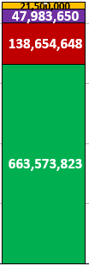
2029 Expansion Construction Projects – $0
Expansion Projects
Planning Costs
Development Costs
Modernization Projects
Preservation Projects

Slide 12
Tentative Program Map Dashboard
https://adot.maps.arcgis.com/apps/dashboards/ce1684c0f0454a179cdef93eadded31c
Available now to public during public comment period
Shows ADOT projects in red and local projects in blue
Includes the Board’s 50% for Greater Arizona only; no MAG or PAG
Searchable by County, COG/MPO, Board District, etc.
Features project maps, descriptions, programmed years, amounts and funding types
Includes a link to comment form and other comment options on ADOT website

Slide 13
Maricopa County Regional Transportation Plan Freeway Program
Five year total $2.5 B
Current TIP runs only through 2025; most funding yet to be programmed in new TIP
Section also includes additional funding provided by the region

Slide 14
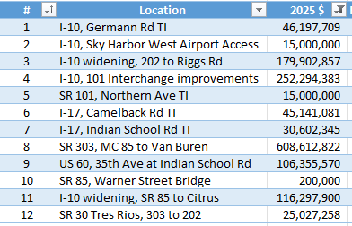
Maricopa County Regional Transportation Plan Freeway Program - Current Projects
5
6
9
7
11
4
2
10
8
12
3
1
Currently programmed projects; projects and amounts may change in the Final Five Year Program.

Slide 15
I-10 Wild Horse Pass Corridor Overview
Segments from north to south:
I-10 Gila River Indian Community Project (design-build), MP 161-172.8
I-10 Gila River Bridges, MP172.8-173.8
I-10 “Gap Project,” MP 173.8 to 177
I-10 “Grant Project,” MP 177-187

Slide 16
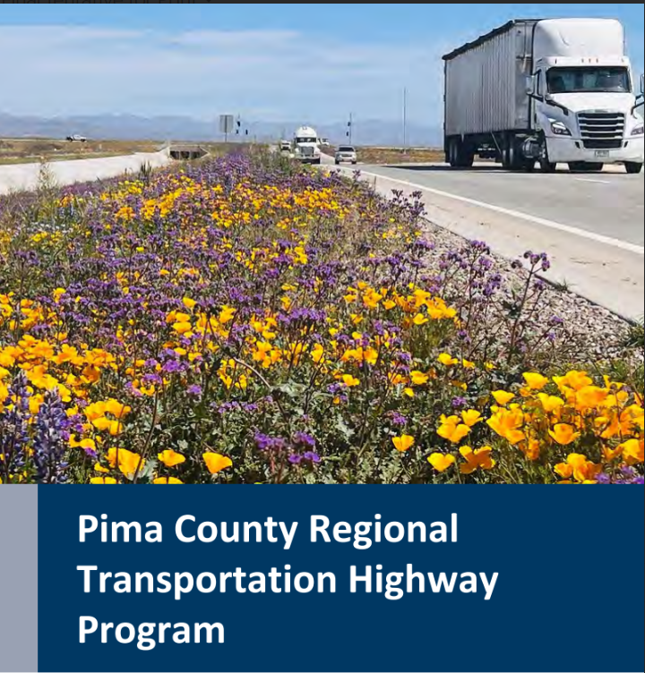
Pima County Regional Transportation Highway Program
Five year total $849 M
13% allocated to PAG for ADOT routes
Current TIP runs only through 2025; most funding yet to be programmed in new TIP
Section also includes additional funding provided by the region

Slide 17
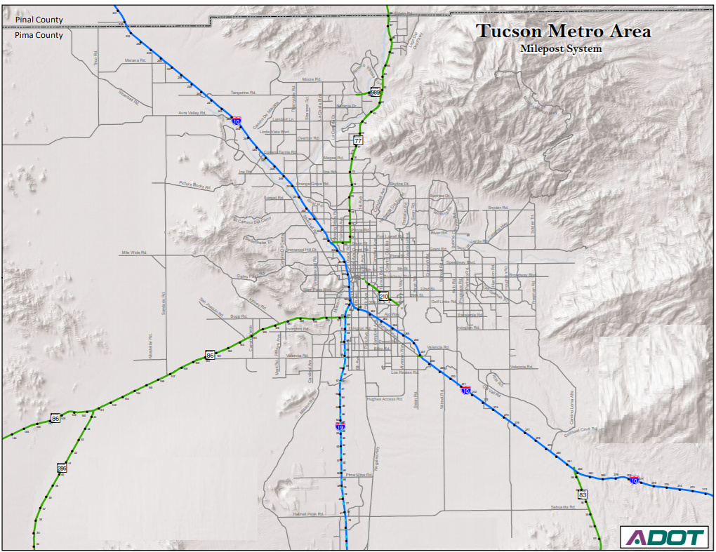
Pima County Regional Transportation Program - Current Projects
1
3
4
1
2

Slide 18
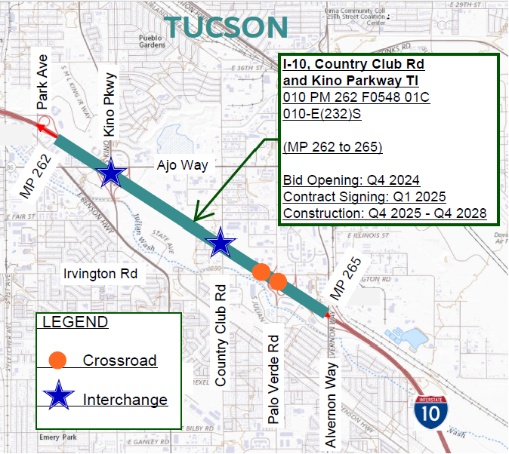
I-10 Widening, Country Club and Kino Rd TIs
Widening from MP 262 - 265
four lanes at Kino
three lanes between Kino and Alvernon
Reconstructing Kino TI
Adding new TI at Country Club
Construction funded over three years (2025-2028) and will take four years to complete

Slide 19
Next Steps
Public Comment Period - March 1 through May 24, 2024
Public Hearing on Tentative Program - May 17, 2024
Board Study Session - June 6, 2024
Final Approval by Board - anticipated June 21, 2024
State Fiscal Year starts - July 1, 2024

Slide 20
Questions

